Slide 1

Advance Data Visualization technique
MD. Arif Istikae Sunny
Senior Artificial Intelligence Engineer
Brain Station 23 PLC
Mobile: 01732009493
Email: Sunny1509006@gmail.com

Slide 2

Contents
Text and Document Visualization
Multidimensional Data Visualization
Comparative Visualization

Slide 3

Text and Document Visualization

Slide 4

Vectorizer
converts a collection of text documents into a numerical format that a computer can understand and analyze. This is called vectorization, and it’s a crucial step in text analysis and visualization.

Slide 5
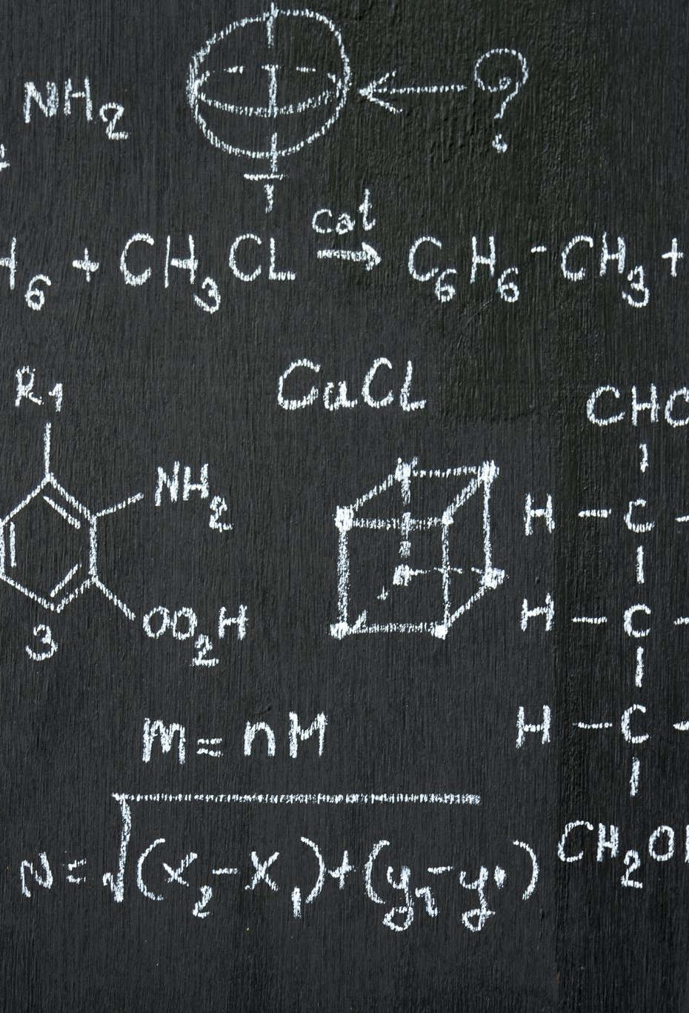
Vectorizer
✅ vectorizer = CountVectorizer(stop_words='english', max_features=1000)
We are creating a CountVectorizer object.
This tool:
Converts text documents into a matrix of word counts.
Removes common English stop words like "the", "is", "and", etc.
Limits the result to the top 1000 most frequent words, so that the data is manageable and only the most important words are considered.

Slide 6

Vectorizer
"This tool reads all our documents and keeps a list of the top 1000 most important words, ignoring very common ones that don’t carry much meaning, like 'the' or 'and'."

Slide 7

Vectorizer
✅ X = vectorizer.fit_transform(texts)
This line applies the vectorizer to our list of text documents (texts).
It returns a sparse matrix X, where:
Rows = individual documents (articles)
Columns = unique words (from the top 1000 list)
Each value = how many times a word appears in a document
🗣️ "This step turns each document into a row of numbers, showing how often each word appears."

Slide 8
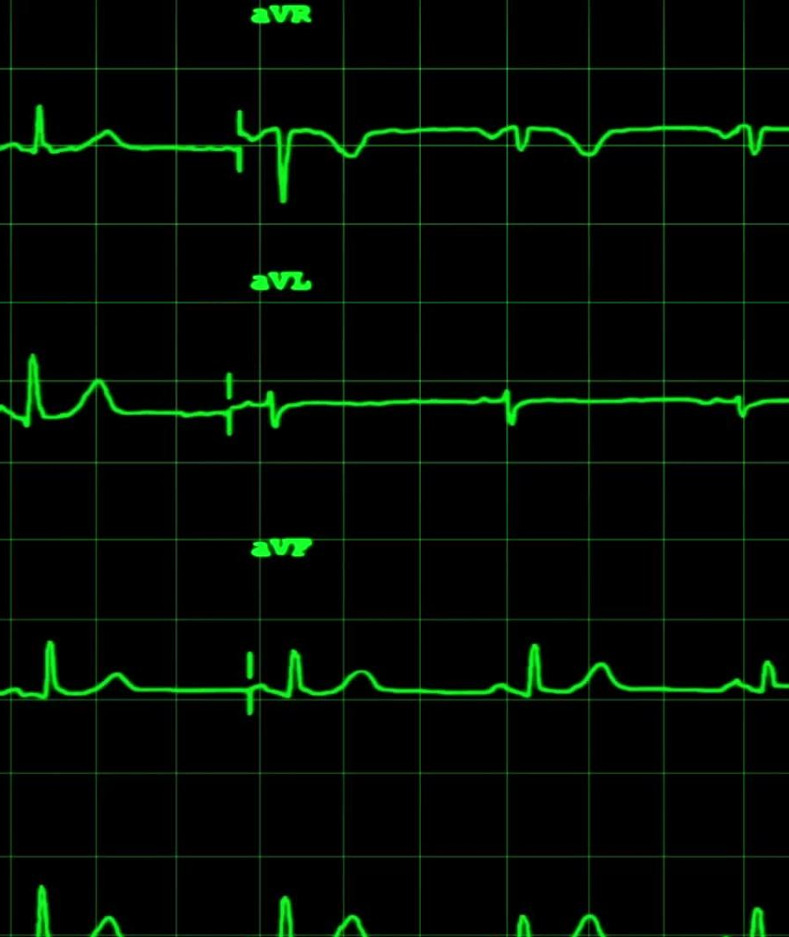
WORD frequency
✅ word_freq = dict(zip(vectorizer.get_feature_names_out(), X.toarray().sum(axis=0)))
vectorizer.get_feature_names_out() gives us the actual words (the vocabulary).
X.toarray().sum(axis=0) calculates the total count of each word across all documents.
zip(..., ...) pairs each word with its total count.
dict(...) converts it into a dictionary format: {word1: count1, word2: count2, ...}
🗣️ "Now we know which words appeared the most across all our documents. We'll use this data to create visualizations like a word cloud."

Slide 9

Why it is important?
This process helps us quantify text so we can:
See which words are most common
Create visualizations (like word clouds or bar charts)
Feed the data into machine learning models

Slide 10

Word cloud
A word cloud is a visual representation of text data where:
More frequent words appear bigger
Less frequent words appear smaller
It helps us quickly understand what the most important or popular words are in a collection of text.

Slide 11
Script breakdown and explanation
✅ wordcloud = WordCloud(width=800, height=400, background_color='white').generate_from_frequencies(word_freq)
This line creates the word cloud.
WordCloud(...) sets up:
width=800, height=400: Size of the image
background_color='white': Background will be white
.generate_from_frequencies(word_freq):
Takes a dictionary where keys = words, values = frequencies
The size of each word in the cloud will depend on how frequent it is

Slide 12
Real-Life Use Cases
Analyzing customer reviews (frequent issues or praises)
Exploring research articles for frequent topics
Social media trend analysis

Slide 13
Common interpolation Options in imshow()
Method | Description
'none' | No interpolation; shows raw pixels (blocky look, good for small images)
'nearest' | Nearest-neighbor interpolation (sharp edges, no smoothing)
'bilinear' | Uses linear interpolation; smooths image edges (default choice for wordcloud)
'bicubic' | Even smoother than bilinear; uses cubic interpolation
'hamming' | Smoother than bilinear; useful in signal processing
'gaussian' | Applies a Gaussian filter while resizing (blurs edges slightly)
'lanczos' | High-quality resampling method; good for photographic data
'spline16', 'spline36' | Higher-order spline interpolations (for very smooth output)

Slide 14
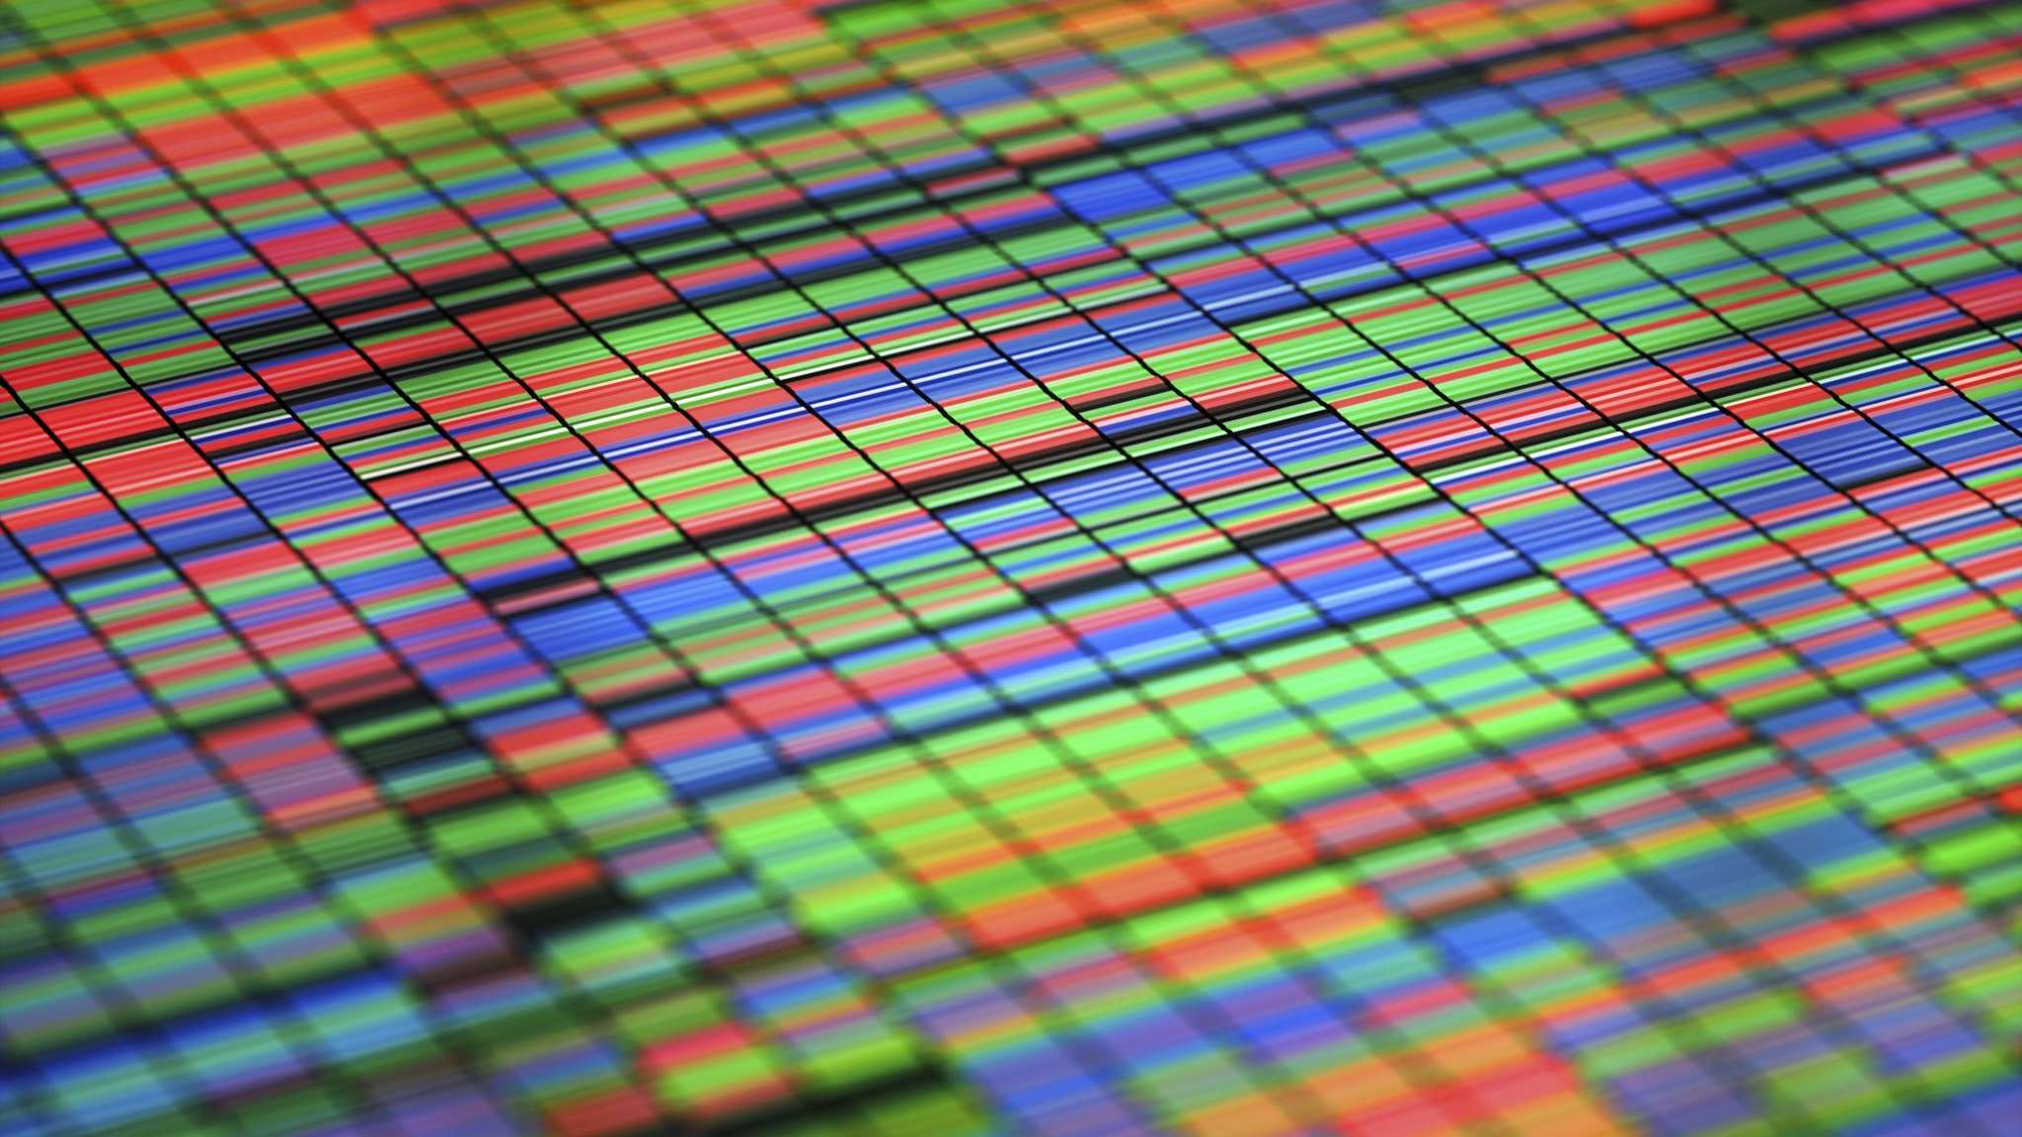
Multidimensional Data Visualization

Slide 15

Reducing Dimensions with t-SNE
# Reduce dimensions using t-SNE
tsne = TSNE(n_components=2, random_state=42, perplexity=30)
tsne_result = tsne.fit_transform(data.data)

Slide 16
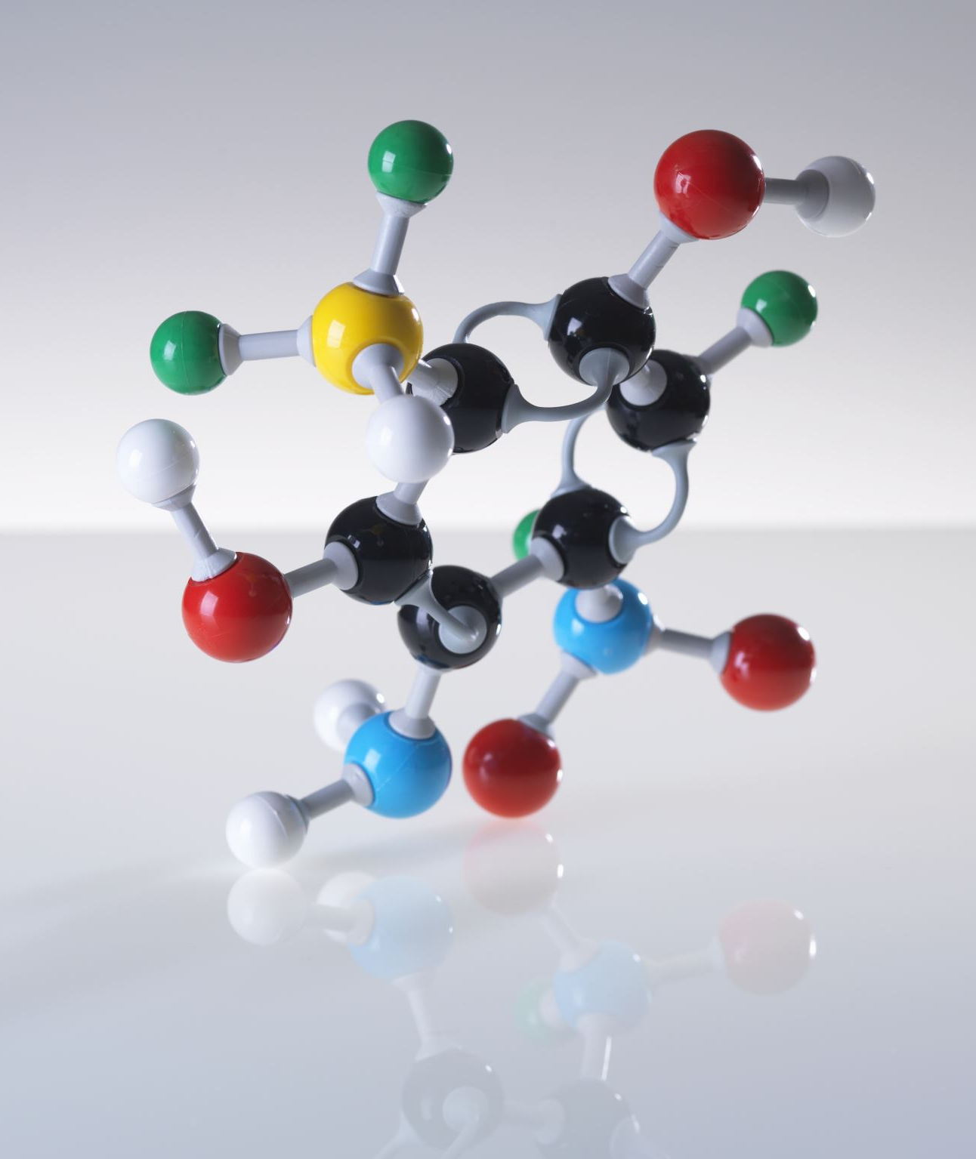
✅ What is t-SNE?
t-SNE (t-distributed Stochastic Neighbor Embedding) is a technique used to:
Reduce high-dimensional data (like 13 features in the wine dataset)
Into 2 or 3 dimensions
While trying to preserve the structure (clusters or similarity) of the original data
🔍 It is great for visualizing complex datasets in 2D space.

Slide 17

T-sne explain
"Imagine each wine sample has 13 chemical properties. That’s like plotting points in a 13D space — which we can’t visualize! So, we use t-SNE to squeeze this down to just 2 dimensions, while keeping similar wines close together. This helps us visualize the hidden patterns or groupings in the data."

Slide 18
Line-by-Line Explanation
✅ tsne = TSNE(n_components=2, random_state=42, perplexity=30)
Creates a t-SNE object with:
n_components=2: We want to reduce data to 2 dimensions (for 2D plotting)
random_state=42: Fixes the randomness for reproducibility (optional)
perplexity=30: Controls how t-SNE balances local vs. global structure (typically between 5 and 50 — 30 is a common value)
🗣️ "You can think of perplexity as how many neighbors t-SNE considers when placing each point."

Slide 19

📊 Why We Use It
For visualizing clusters or patterns in complex data
To see which groups are similar or different even if the data is high-dimensional

Slide 20
How t-SNE Converts 13 Features into 2
🔢 Original Situation:
Each wine sample has 13 features (like alcohol, malic acid, magnesium, etc.)
So each sample is a point in 13-dimensional space
But we can’t visualize anything in 13D — we need 2D or 3D

Slide 21
What t-SNE Does (Conceptually)
t-SNE is not just a projection or compression — it is a nonlinear technique that tries to:
Measure similarity between every pair of points in high-dimensional space.
Map those points into a low-dimensional space (like 2D), trying to keep similar points close together.
Pull apart dissimilar points, so clusters become more visible.
t-SNE is like organizing a crowded room of people into small friend groups based on how close they feel to each other.

Slide 22
🔧 Step-by-Step Intuition
In High Dimensions (13 features):
t-SNE calculates how close each sample is to others using a probability distribution.
Closer points get higher probabilities of being neighbors.
In Low Dimensions (2 features):
It tries to place the points so that the distance-based probabilities in 2D match those in 13D as closely as possible.
If two points were close in 13D, they should also be close in 2D.
If two points were far, they should be far in 2D.
Optimization:
t-SNE uses a technique called gradient descent to minimize the difference between the high-D and low-D similarity distributions.
The result is a set of 2D coordinates that best preserve the relationships.

Slide 23

🎯 End Result
Instead of a 13-dimensional vector like: [13.0, 2.0, 2.3, 15.6, ..., 1.2] You get: [24.5, -3.2] — which are 2D coordinates you can plot

Slide 24
🔍 Important Notes
t-SNE does not preserve actual distances or directions, only neighborhood relationships.
It’s great for visualization, but not ideal for prediction or feature reduction for models.
It’s nonlinear, meaning it doesn’t linearly scale down like PCA does
“t-SNE is like taking a messy group photo of people in 13D, then arranging them in 2D so that friends (similar items) stay close and strangers (dissimilar ones) stay apart. It doesn’t preserve exact distances, but it reveals natural groupings and patterns.”

Slide 25
🔄 Why the Values Change After t-SNE
t-SNE doesn't preserve original feature values or distances
It doesn't try to keep the same numeric values as the original 13 features.
Instead, it learns a new 2D coordinate system that reflects the similarity between points.
It’s a nonlinear transformation
So the scale, direction, and distances are all relative and not interpretable numerically.
t-SNE could rotate, flip, or stretch the data — and that’s okay — as long as:
Points that were close in 13D are still close in 2D, and far ones stay far.
Axes in t-SNE have no real-world meaning
Unlike PCA, the axes are not "feature 1" and "feature 2"
You should not interpret x = 10 or y = -0.5 as specific chemical values

Slide 26
📈 What to Understand from This Plot
✅ Each dot = one wine sample
✅ Colors = different wine types (target 0, 1, or 2)
“t-SNE creates a new 2D world where we can see relationships that were hidden in 13D. The actual X and Y values are not important — what matters is how close the points are. The plot shows that class 0 wines are quite different from others, but class 1 and 2 wines are harder to separate.”

Slide 27

Comparative visualization

